Slide 2
Creating the conditions for good higher education governance
Victoria Holbrook – Assistant Director
Victoria.Holbrook@advance-he.ac.uk
Notes:
My name is Victoria Holbrook. I am delighted to be speaking to you today.
I am Assistant Director with responsibility for higher education governance at Advance HE.
We train nearly 1000 governors and governance professionals every year.
We conduct reviews of governance effectiveness at universities.
We share practice and lead change projects such as how to diversify the membership of governing bodies.
My background is as a senior public servant, working for the English government bodies for higher education on funding and regulatory policy in a number of areas such as widening participation, health education provision and effective university governance. I experienced the change in regulatory system and approach in England which took place in 2018 and I will reflect on that today.

Slide 3
Today
What can HE governance systems look like?
What levers can be used to drive progress?
What do we know about good governance practice in universities?
Notes:
I have been asked to talk about how governance can work effectively to deliver the country’s aims and ambitions for higher education.
We will cover:
What a systems approach to governance can look like.
What levers can different parts of the system use to drive progress and improvements.
What do we know are the features of good practice in English universities?
I will be drawing on the English experience because it is one of the most developed approaches to HE governance and has undergone significant change in the last few years, which provides opportunity for reflection.
I am not recommending how things should be done in Uzbekistan; you will decide what is most appropriate for your operating context.
My slides contain quite a lot of text in English but I will not be speaking to all of it . The slides will be translated and shared afterwards.

Slide 4
Uzbekistan ambitions for HE
Autonomy
Increase participation
Achieve research potential and rankings
Improve facilities, student experience, teacher motivation, foreign language skills
Better industry/employer links
Recognised international centre for intellectual and applied expertise
Enhance society and culture in Uzbekistan
Notes:
To recap, we understand these to be your key ambitions for HE . Clearly, effective governance throughout the system from government to student will help you deliver these. I am going to particularly focus on increasing participation and the role of autonomy in this session, but everything we cover will have implications for the whole strategy.

Slide 5
Regulatory choices
Hard
Transactional
Assurance
Data
Compliance
Sanctions
Soft
Strategic
Enhancement
Good practice
Commitment
Incentives
Co-regulation – in partnership
Respects and supports autonomy
Uses soft power as much as sanction
Based on trust
The role of governance and opportunity to bring in industry/employers
Notes:
We have talked about this before. Uzbekistan as it develops its system and approach has some choices to make about how it exercises powers and where. And how different parts in the system work together. I will illustrate some of this.

Slide 6
What is the purpose of governance?
To provide confidence and clarity for all stakeholders
To ensure organisations and systems deliver what they are meant to e.g. financially sustainable and good student outcomes, the delivery of strategy, achieve performance measures
Notes:
I wanted to begin by reminding ourselves what the overarching purpose of governance is. It can be easy to forget about the first statement and focus on the second. But confidence and clarity for stakeholders is vital to securing your objectives – it means people, investors, governments, partners trust you and are more likely to want to work with you. It requires something more than just doing a good job, but being able to evidence and communicate that well.

Slide 7
Themes in global governance
Transparency…
Impact…
Evidence…
Social responsibility…
Voices…
Notes:
When we look across the world and other sectors such as banking, corporate, charitable we can see some themes emerging in how institutions are governing themselves, and how stakeholders want their institutions to be governed.
Transparency, of how decisions are made and by who
Impact, clarity around what difference are we making and outcomes are we achieving
Evidence, decisions being made based on strong evidence and thoughtful approaches to risk
Social responsibility, playing a role in the world beyond financial contribution
Voices, giving stakeholders including users more say in what happens and how things are done

Slide 8
A systems approach
Code/good practice
Regulation/ law
Governing docs
HE governance
Always a balance between
Government & law
Sector self-regulation
Institutions
Notes:
So bearing those themes in mind, what and who makes up the governance system?
it is a balance between government, the sector and institutions comprising formal and informal elements of governance, some of which is prescribed and codified and some of which is about collaborative working and action.

Slide 9
What roles are there?
Government
Regulator
Sector organisations
Institution governing bodies & Chairs
Institution leaders
Institution secretariat
Students
Staff, employers, communities
Notes:
There are a large number of roles to consider as part of the system of governance
We will now look at some of these and the levers they have, in the context of wanting to increase the number of HE students and improve quality. I’m going to show you how this would have worked in England up to 2018, and then since 2018.

Slide 10
Increase entrants and quality of student experience – England before 2018
Government
Advancement body
Vice-Chancellors Group
Institute governing body
Chairs Group
Funding Council
Access body
Students
Institute leadership
Academic governance system
Quality agency
Notes:
This a simplified version of what the HE system looked like in England. The red labels denote the formal government structures. But this was not a highly regulated approach – the system operated with a very high degree of autonomy given to providers. The key lever government had was the public funding given to institutions via the funding council.
Note that there is a line between the funding council and the advancement body, so the government was keen to fund and support the development of practice and people in support of government aims and a healthy system.
Note that the primary relationship on academic quality matters is at a relatively low level between the quality agency and the institution – was it too focussed on process not outcomes?
We will return to the role of the Vice Chancellors Group and the Chairs Group later.
Note that students feel set apart from the system in any formal sense.

Slide 11
Actor | Levers | Examples
Government | Policy direction, law, money | Student number/fee caps Grants to students Funding for access monitoring body New types of course
Funding Council (HEFCE) | Funding and sharing practice, enhancement, assurance ‘Nudge’ conversations Grant funding to institutes Advise government | Funding for new courses and growth, support for students Funding of programmes/practice 5 year assurance checks
Access body (OFFA) – more disadvantaged students into HE | ‘Permission to act’ Monitoring | Requiring approved plans and progress
Quality agency (QAA) | Inspection Enhancement activities | 4 year cycle Published reports
Sector-owned enhancement bodies (learning and teaching, leadership and governance, EDI) (HEA, LFHE, ECU) | Use of public funding to focus on key areas Share practice & convene practitioners | Subject centres e.g. STEM Governor Development Programmes EDI advice, challenge on progress
Notes:
So who was doing what to ensure that HE participation increased and education was of good quality?
I will draw out a few key points.
Funding was used as the main lever,
- either to increase or decrease student numbers through caps on how many places the government would fund
- to fund programmes such as outreach into regions and communities with low participation rates
to develop practice such as learning and teaching improvements
To try new types of courses or subjects
The other feature was regular inspection by the quality agency for education and by the funding council for overall approach to governance and assurance. These were fairly formulaic and process driven. Reports delivered action plans, but very little sanction or implications.

Slide 12
Actor | Levers | Examples
Institutions – Governing body | Approve decisions about growth Help decide strategy & performance measures Monitor progress, act if required, use of audit Self-regulation against Code | Expansion plans – new courses, new partners, international Address recruitment strategy Sign off on accountability checks to/by Funding Council
Institutions - Leadership | Understanding market conditions Performance management Oversight of academic portfolio and quality – teaching and research | Making sure access agreement in place with OFFA Ensuring funding spent, HEFCE & QAA happy Autonomy to act
Institutions - secretariat | Formal compliance requirements low | Annual sign off
Students | Engagement and voice | Emerging practice – embedding within academic governance
Wider stakeholders (staff, employers, communities) | Engagement and voice | Emerging practice – embedding within structures & good communication
Notes:
within the institution, governance regarding quality of the student experience was largely left as a managerial task within the committees and structures of the institution. The governing body did not play a very active role in education matters, but would focus on overall strategy, growth, financial resilience. League table performance often a key measure of success.
Students as stakeholders in governance and being able to add value to how their student experience could be improved was an emerging theme, but not yet considered important by the system overall. The same is true of employer engagement
Overall, highly autonomous institutions could get on with things and keep their funders happy quite easily.
The incentive to drive up participation and quality relied heavily on values.

Slide 13
Increase entrants and quality of student experience – England since 2018
Advancement body
Government
Vice-Chancellors Group
Institute governing body
Regulator
Students
Chairs Group
Data body
Institute leadership
Academic governance system
Quality agency
Notes:
So what changed and why?
Broadly, England has one of the most expensive HE systems in the world. Government believed that institutions were receiving too much public money for not enough accountability. Particularly, they grew concerned about the quality of teaching and outcomes being fair for all students. They also thought progress was not being made quickly enough on social mobility – so a focus on not just getting students into higher education, but what did they go on to do afterwards? What value was HE really providing to students and the taxpayer? A very difficult question to answer.
This created the political case for change and a new regulatory system came into being in 2018.
The key aspects of this are:
The main lever is no longer funding, it is regulation and the ability to comply with the conditions set by the regulator. But it importantly takes a risk-based approach, so we don’t have inspection on a regular basis, but only when the regulator thinks necessary.
And crucially for institutions, the expectations of the regulator more explicit and place much more onus on the institution’s governance at the highest level to be assured about standards and quality, as much as financial sustainability.
So the stars here represent what has changed – funder to regulator, students at the heart of things, and the primacy of institutional governance.
Another key element is that the regulator does not see a key role for itself in advancing practice or developing the system i.e. teaching and learning practice or leadership capability. It sees those as matters for institutions and continuous improvement. The only area it does provide support around is access and participation.

Slide 14
Actor | Levers | Examples
Government | Policy direction, law, money | Marketization and new entrants Setting up new types of education/qualifications Funding policy programmes Fees policy
Regulator (Office for Students) | Registration and monitoring Access and participation drive with funding Principles, not rules | Conditions of registration/de-registration of providers Access and participation plans Funding for courses/students
Data body (HESA) | Collection and publication of data for direct & indirect regulatory use | Publication of participation rates and outcomes data Use of data in OfS monitoring
Quality agency (QAA) | Risk-based interventions instructed by OfS Enhancement activities | Check new market entrants against standards or investigations based on concern Published reports
Sector-owned development and enhancement body (Advance HE) | Improve practice & convene practitioners/ accredit Member and client funded – identify and meet needs | Charters for gender and race equality Teaching fellowship accreditation Governance/leadership training
Notes:
Again there is lots of detail here and I highlight a few key points.
The primacy of the conditions of registration as driving practice, especially on access and participation where targets are set.

Slide 15
Actor | Levers | Examples
Institutions – Governing body | OfS registration/condition compliance – assurance Interface with academic governance and students Progress against strategy/performance measures Self-regulation against Code | Receiving and testing student outcomes assurances Engaging directly with students Approving expansion/market plans including international Broad concept of risk beyond financial
Institutions - Leadership | Understanding market conditions Performance management Oversight of academic portfolio and quality & ensuring assurance to Board | Action plans Recruitment/retention strategies Compliance Focus on role in community or region
Institutions - secretariat | Formal compliance requirements higher/more challenging as new | Responding to changes in regulatory requirements, evidencing assurance
Students | Engagement and voice | Expected practice – embedding throughout governance
Wider stakeholders | Engagement and voice | Emerging practice
Notes:
where this has arguably made a big difference is the approach to governance within the institution as it relates to student numbers and quality of education.
The clear regulatory expectations mean governing bodes have to know more, understand more and it is their assurance that matters to the regulator.
But the burden of compliance is higher as more evidence is sought and needed.
However, students as stakeholders in governance are front and centre. This is also translating to other stakeholders.
So what does this comparison between the old system and the new tell us? Clearly, different actors in the system can use different levers, but incentives need to be used carefully. There are advantages and disadvantages to both approaches, and it is still too early to tell in England, which is best for delivering the government’s aims.

Slide 16
The role of sector-led enhancement and self-regulation
Chairs Group (CUC)
Vice-Chancellors Group (UUK)
Advancement body (Advance HE)
Voluntary
Membership group
Independent
Lobby government/regulator
Convene
Safe space
Support each other
Demonstrate leadership & fitness for autonomy
CUC HE Code of Governance
Voluntary
Membership organisation
Independent
Lobby government/regulator
Convene
Safe space
Support & inform practice
Demonstrate leadership & fitness for autonomy
Initiate/deliver policy programmes e.g. mental health
Voluntary
Membership organisation
Independent
Convene & share practice
Provide standards/frameworks and accreditation to demonstrate performance
Support & improve practice
Evidence of reality for all
Developing staff talent and capabilities - PEOPLE
Notes:
Clearly the relationship between the regulatory bodies and the institutions themselves is key, but other actors can also play key roles.
In England there are three key groups that influence practice and behaviours by institutions and can be seen as self-regulation.
The Chairs group develops and issues voluntary codes of conduct on institutional governance. Adherence to these can be used as evidence to submit to the regulator that you are meeting your conditions.
The Vice Chancellors Group provides a forum for universities to have a shared voice or take forward initiatives in their own right. They also lobby government and the regulator.
The advancement body provides services to enhance practice and accredit success, giving the sector confidence in what is doing and recognition for key achievements. It responds to the needs identified by its members – the universities – and so helps keep the system healthy.

Slide 17
University-level governance
Your constitution +
Regulatory requirements +
Voluntary Code +
Culture
Notes:
I’m going to talk briefly about university level governance and effectiveness.
In England it is these factors which make up the governance approach. The most important one of these being culture.

Slide 18
Features of good governance?
The quality and make-up of leadership throughout
Clarity of structures, roles and responsibilities
Culture and values:
Trust
Transparency
Healthy challenge
Respect
Diversity of perspective & inclusion
Permission to take calculated risks and learn
Agility
Focussed on continuous improvement – looking ahead
“Culture eats strategy for breakfast”
Notes:
So why is culture so important to governance?
Because it looks beyond the processes and structures - although those remain important – and considers the ways of doing things that mean that results can be achieved best. It is about collegiality but also about professionalism. Much research has been undertaken into how Boards work, and how strategy is delivered. The key thing people come back to is culture. And this famous phrase ‘culture easts strategy for breakfast’. Meaning if you do not understand your culture and it is not conducive to delivering your goals, your strategy won’t exist for long.

Slide 19
Diversity in leadership and governance matters
Gender balance on Boards in UK HE = 41% female
The staff population in UK HE is over 50% female
Even more work to do for others e.g. black and minority ethnic
Not about numbers – its about avoiding ‘groupthink’
Different perspectives to help solve problems
Range of lived experiences informing and testing plans
Closer to & more representative of your stakeholders
Levers include: Quotas, frameworks, development programmes, sharing practice
Notes:
Diversity of perspective is one of the key things we are working on in HE governance. Who gets a seat at the table matters and it matters to building trust and confidence with our stakeholders.
More than that though, there is emerging, strong evidence in the corporate sector that diverse boards and leadership lead to better performing organisations. If we are serious about equality in society and social mobility, then we need to ensure that reaches into our governance systems at all levels. If there is opportunity to strengthen that, it should be taken.

Slide 20
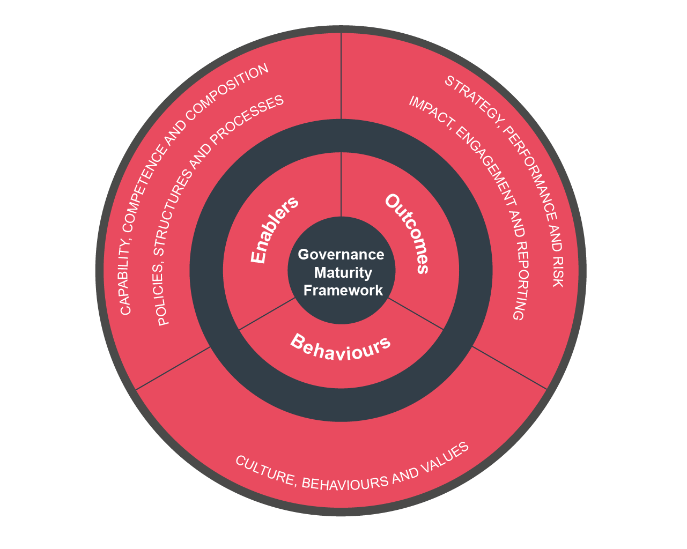
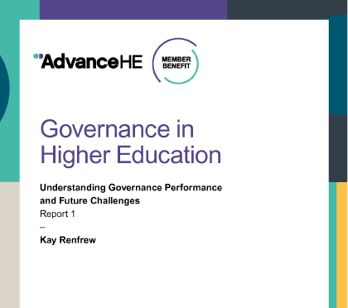
Features of good governance?
Notes:
We have a framework which we use at Advance HE when we evaluate the effectiveness of universities governance. It is based on research and the themes I identified at the beginning of this session. It helps us understand how far governance is delivering against those two key tests of purpose – confidence and trust for stakeholders, and delivering what you ought to be.
While university governance in the UK is generally well developed, it is still adapting to shifts in the regulatory and operating environment . Effectiveness needs to be tested regularly to ensure continuous improvement.
When we analyse all the work we do with institutions, we still find there are some persistent issues, around diversity, induction, confidence to assure academic matters, clarity around strategy and performance. We also find that universities tend to rate themselves better than our judgement would rate them. So having checks and balances is a good thing. It is our job to hold the mirror up and support the system to be the best it can be.

Slide 21
References
Diversity of governors in UK HE https://www.advance-he.ac.uk/knowledge-hub/diversity-governors-higher-education
CUC HE Code of Governance https://www.universitychairs.ac.uk/wp-content/uploads/2020/09/CUC-HE-Code-of-Governance-publication-final.pdf
Advance HE governing body effectiveness framework https://www.advance-he.ac.uk/knowledge-hub/framework-supporting-governing-body-effectiveness-reviews-higher-education and
‘Governance in higher education: understanding performance and future challenges’ https://www.advance-he.ac.uk/knowledge-hub/governance-higher-education-understanding-governance-performance-and-future
‘Governing Higher Education Today: International Perspectives’ 2019, ed. Tony Strike (Routledge)
Notes:
I’m stopping here. I have noted some references, but I hope that has been a useful exploration of governance systems at work to deliver strategy, the roles different actors can play and some of the choices we have in ensuring governance is fit for purpose.
Thank you.

